Slide 1
DSO Project 2 - Phase 3
By Amanda Cashman, Jou An Lin, Kayla Yedidsion, Yuzi Sun, Brynne Di Donato, Wei Chien Chang, Meg Gupta, Josh Sherman

Slide 2
Phase 1 & 2 Summary
Business Goal: Our business goal is to analyze the relationship between gross revenue and several other factors such as yearly unemployment rate, rating, genre, year, country, and more.
Dependent Variables: Gross Revenue (numeric variable)
Independent Variables:
Numerical Variables: Budget, Runtime, Unemployment Rate, Employment Rate, IMDB Score
Categorical Variables: Year, Genre, Country, Movie Rating
Calculated Variables: Unemployment Rate, Employment Rate
Data Source 1: Movie Industry Analysis - access data set
File 1 (Movie Data): 7,668 rows
Data Source 2: US Employment & Unemployment Rate since 1940 - access data set

Slide 3
Phase 1 & 2 Summary Cont.
Number of Observations:
File 1 (Movie Data): 7,668 rows
File 2 (Employment Data): 71 rows
Files: 2 files, inner join (common variable: year of movie release)
Correlations: Each variable has a statistically significant relationship with gross revenue (p < .05) - budget has the strongest correlation
Analysis:
Positive correlation between employment rate and mean gross revenue - better economics conditions lead to more revenue success for films
Family-friendly movies had higher mean gross revenue compared to niche genres and movies with limited age ranges

Slide 4
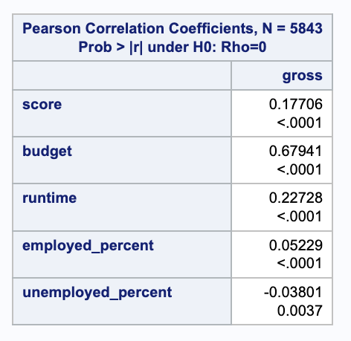
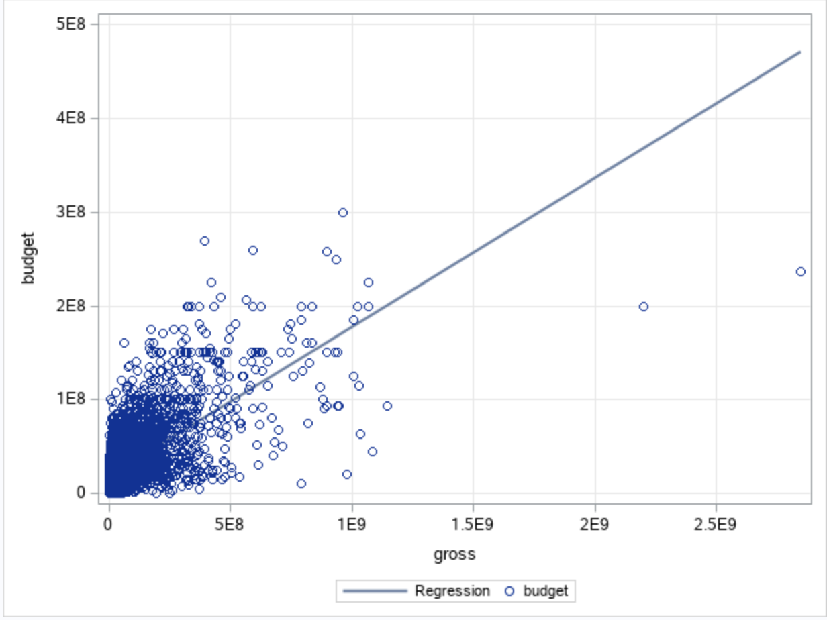
Phase 3 - Correlations
Each variable has a statistically significant relationship with gross revenue (p < .05)
Budget has the strongest correlation (shown in the scatter plot)
Notes:
Jou ann

Slide 5
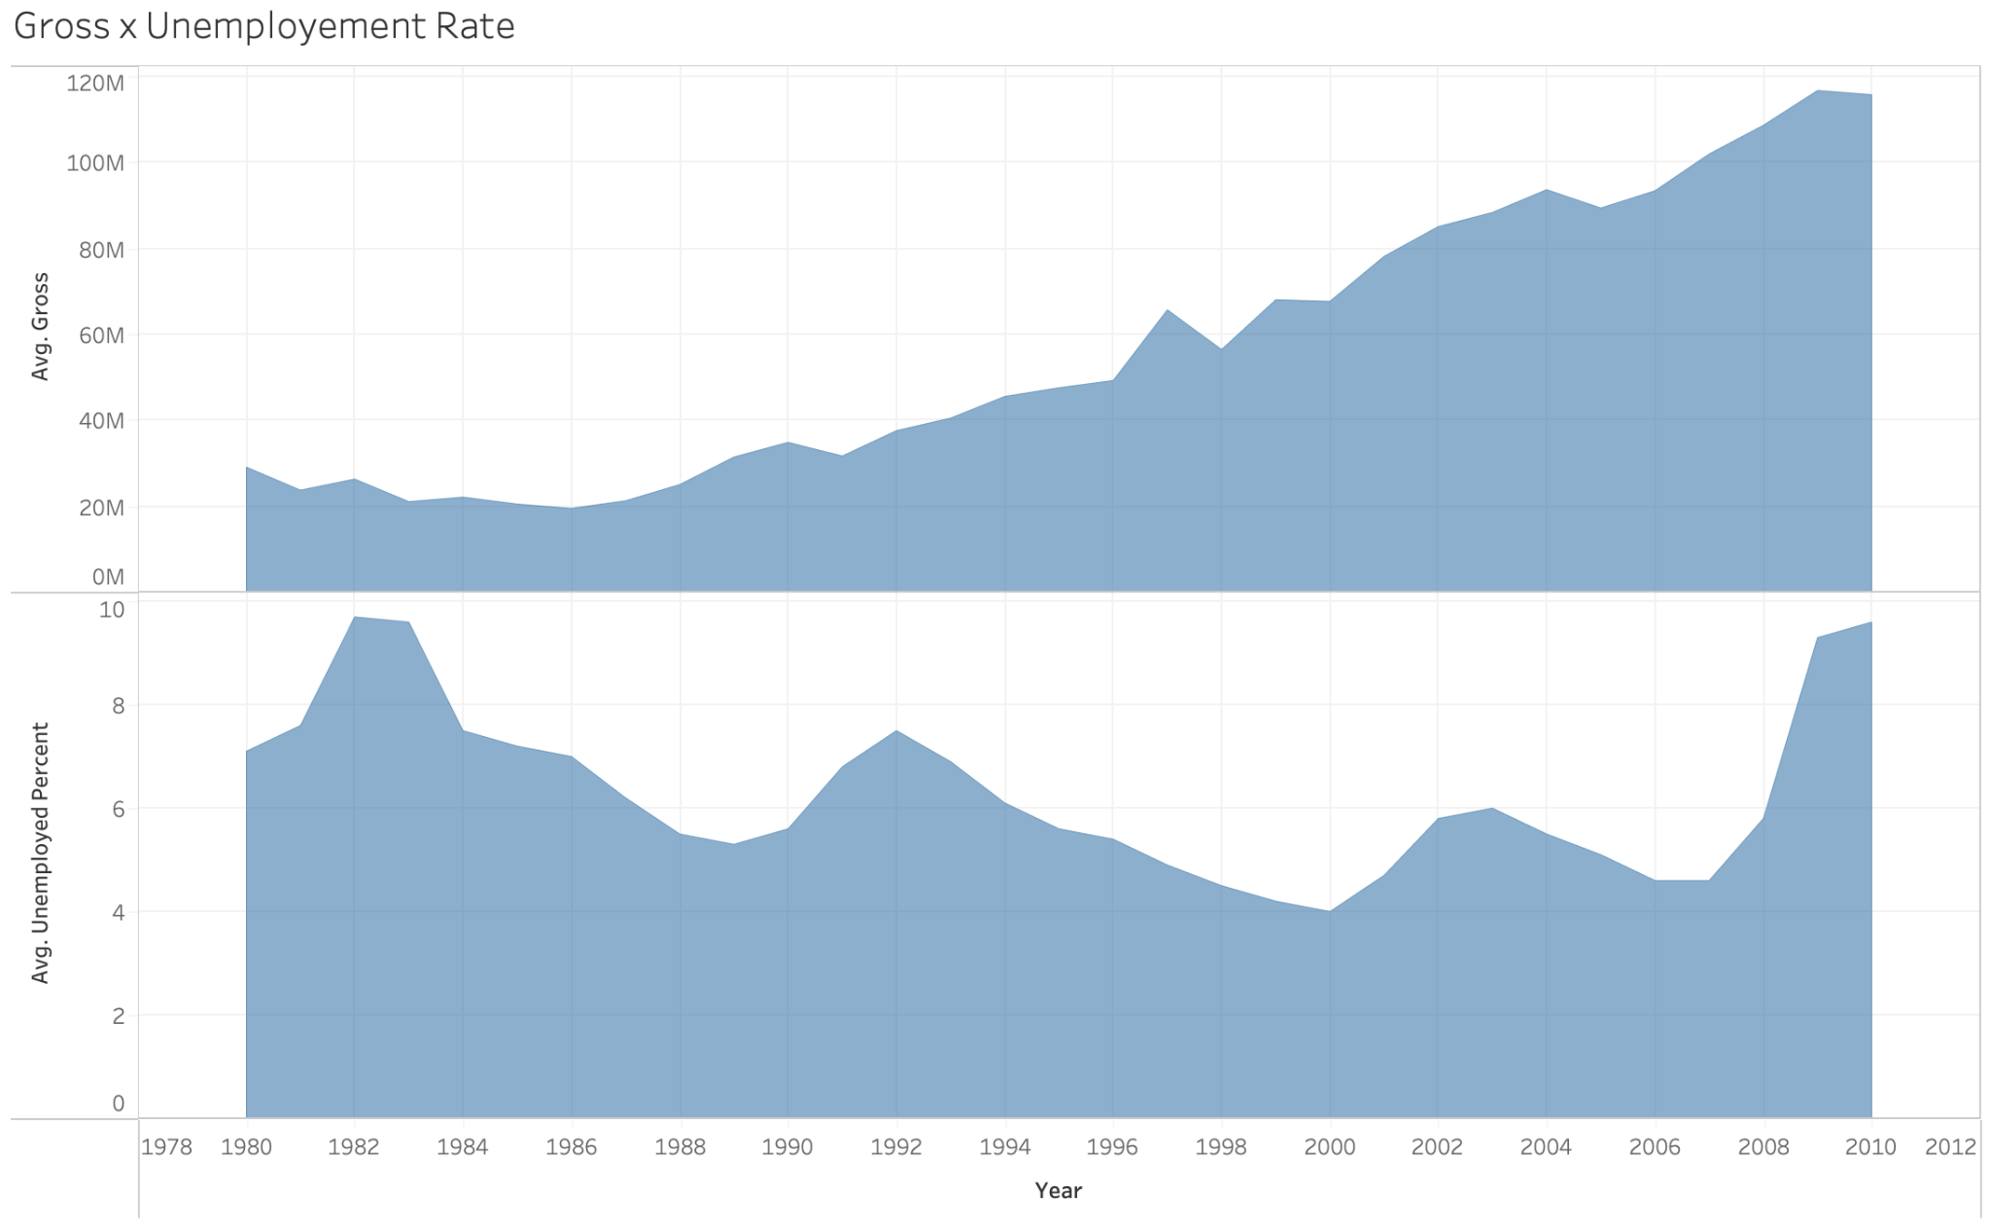
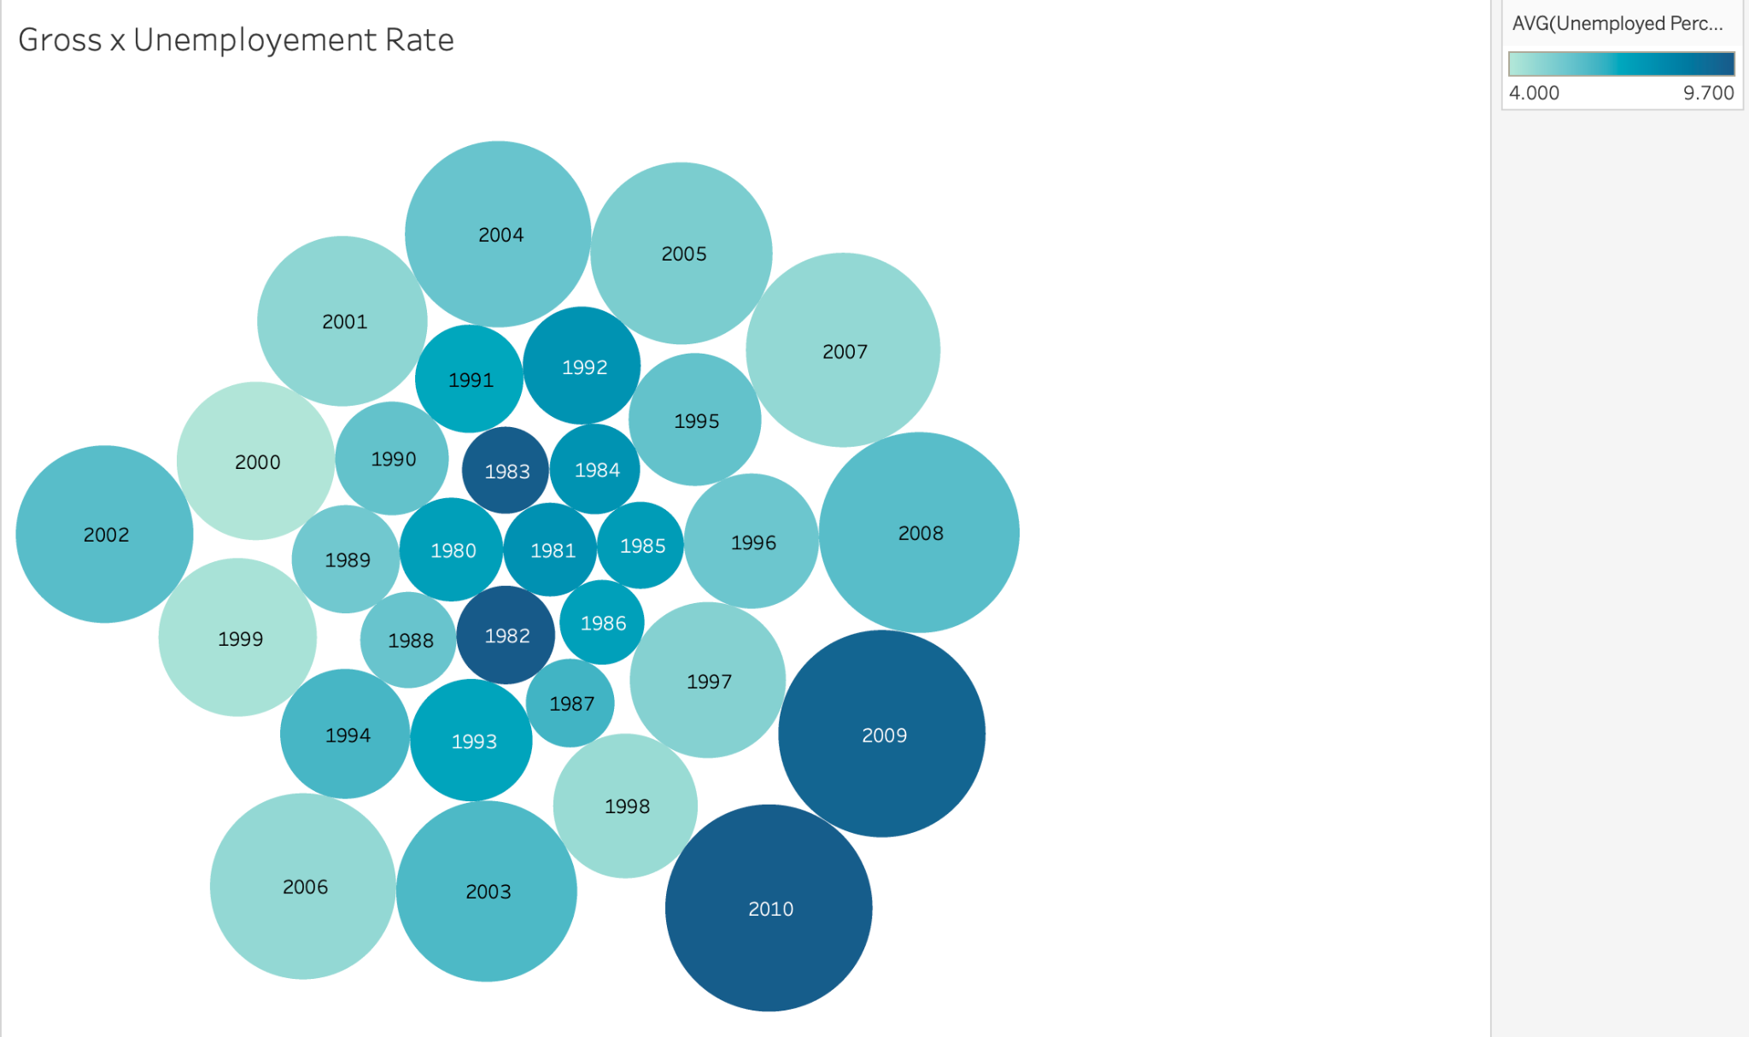
Unemployed_percent
The gross revenue grows every year, even in years with a relatively high unemployment rate.
The graph on the right shows several years of high gross revenue with a low unemployment rate, proving “unemployed percent” and “gross” are negatively related but weak.
Notes:
Jou ann

Slide 6
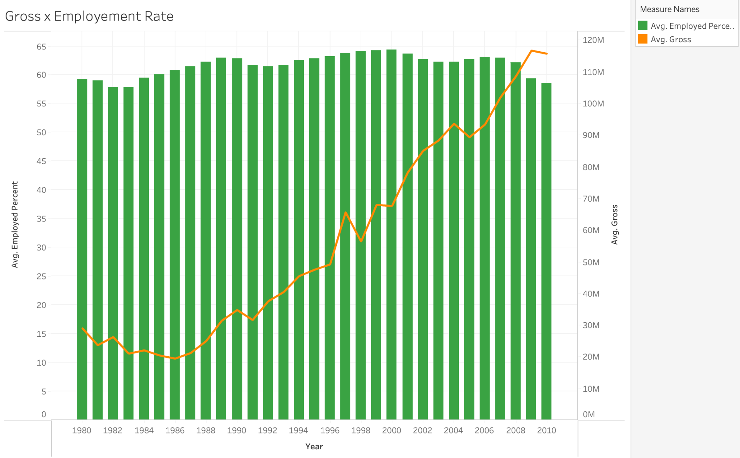
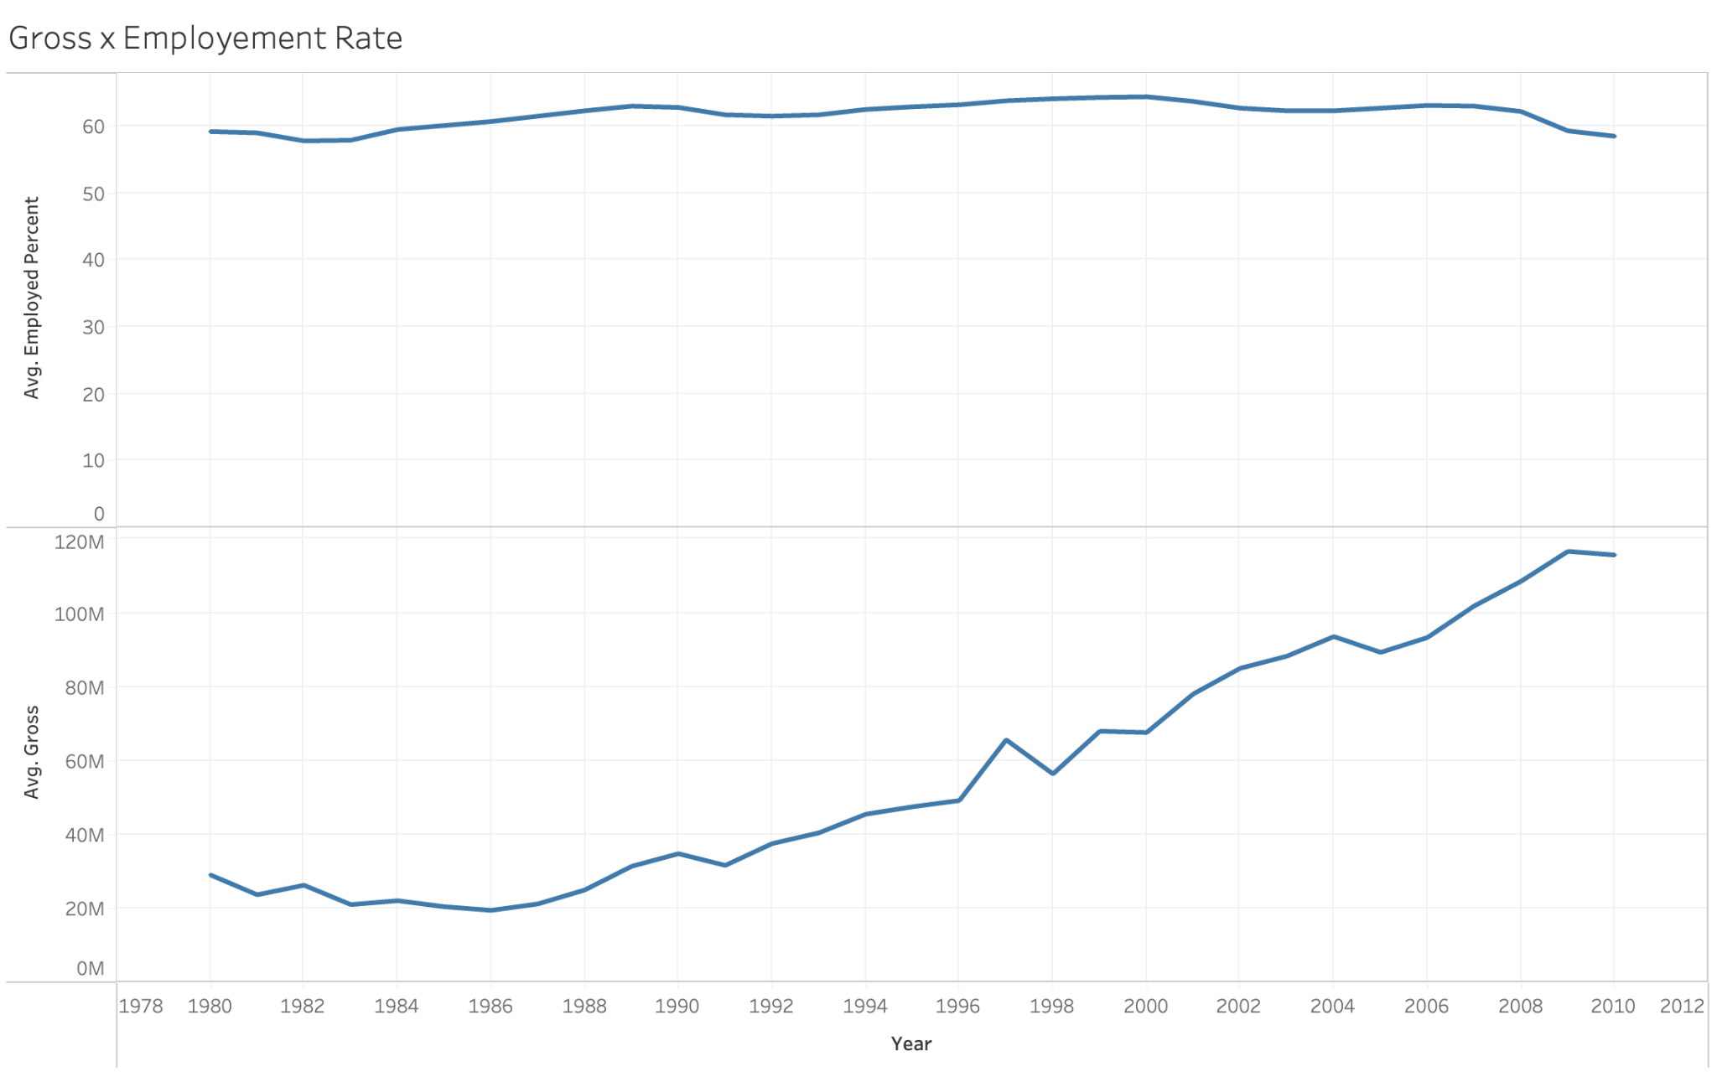
Employed_percent
The gross revenue grows every year, and the employment rate is steady.
The graphs show weak relationship between “employed_percent” and “gross”.
Notes:
Jou ann

Slide 7
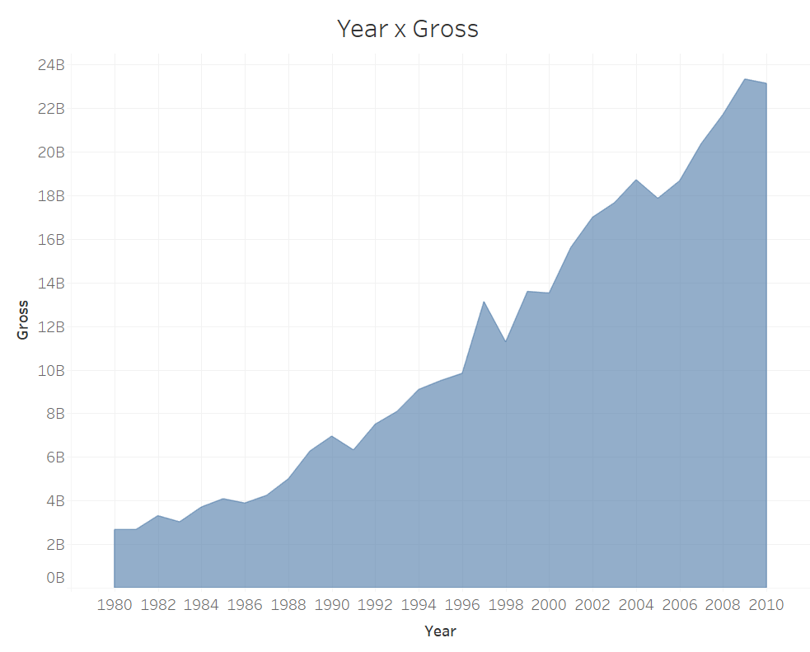
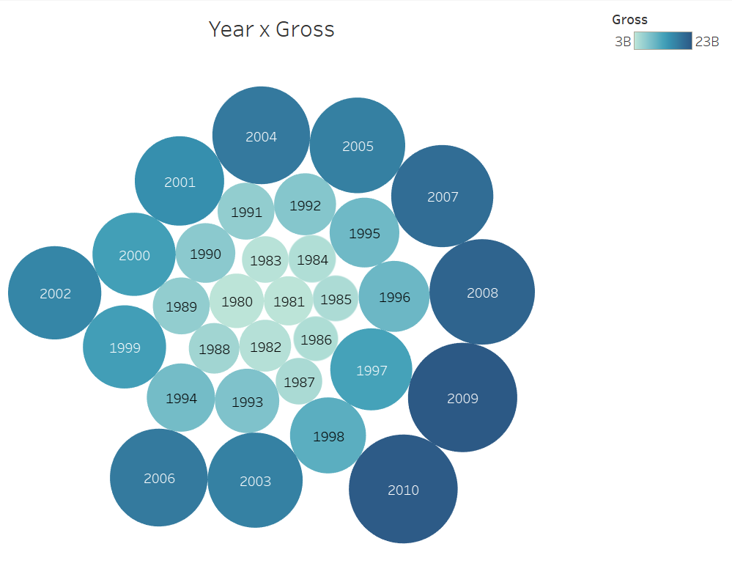
Year
Both graphs show that there is a positive relationship between Year and Gross Revenue. Gross Revenue keeps increasing as time goes by. Starting from 1996, there has been a drastic growth and gross revenue reached 23B in 2010, which is almost 12 times as much as 1980.
Notes:
Genre x year?
Is there a possibility that movie genre increases in recent years? → more genre, more revenue?

Slide 8
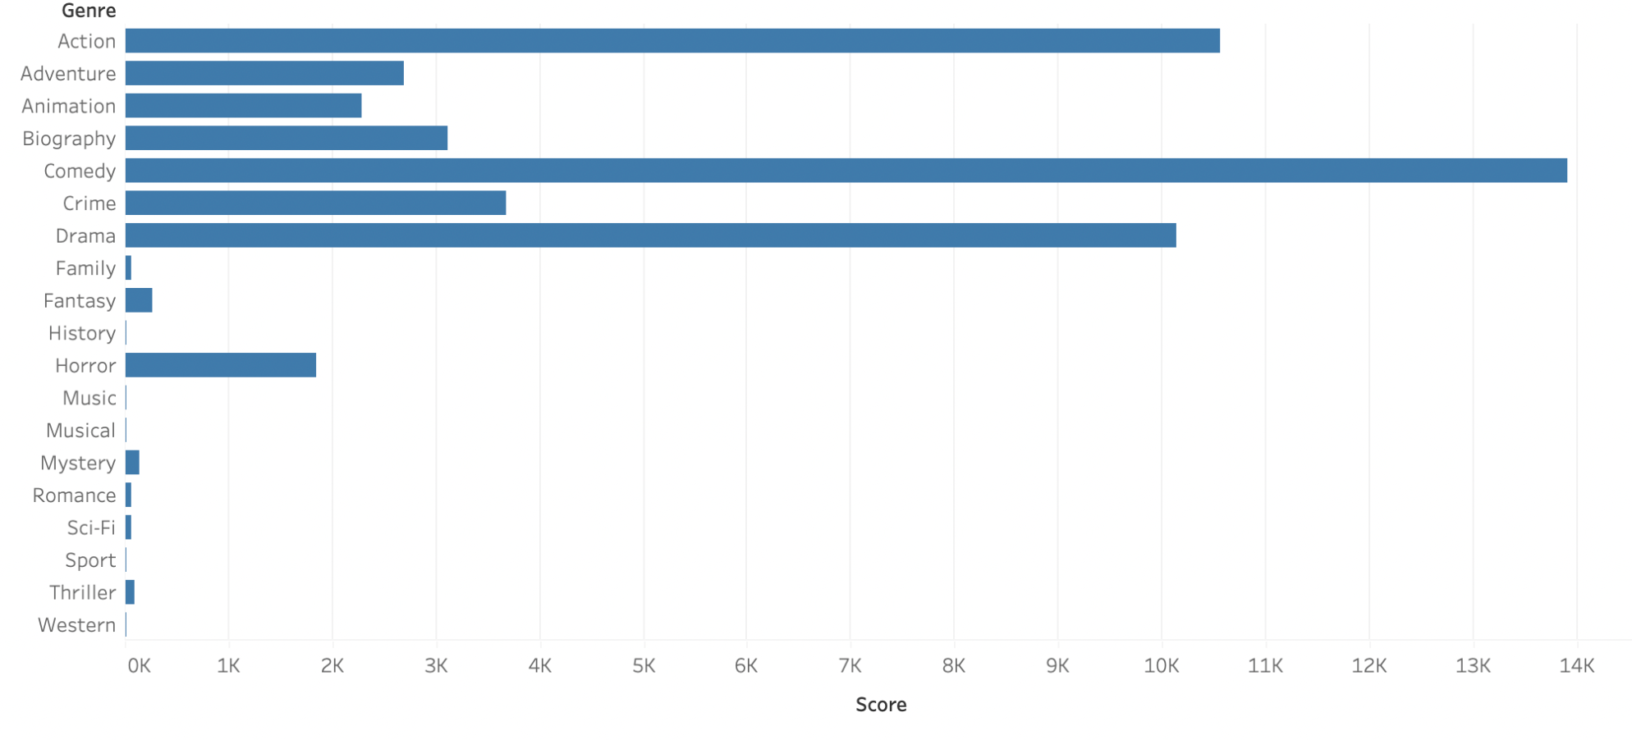
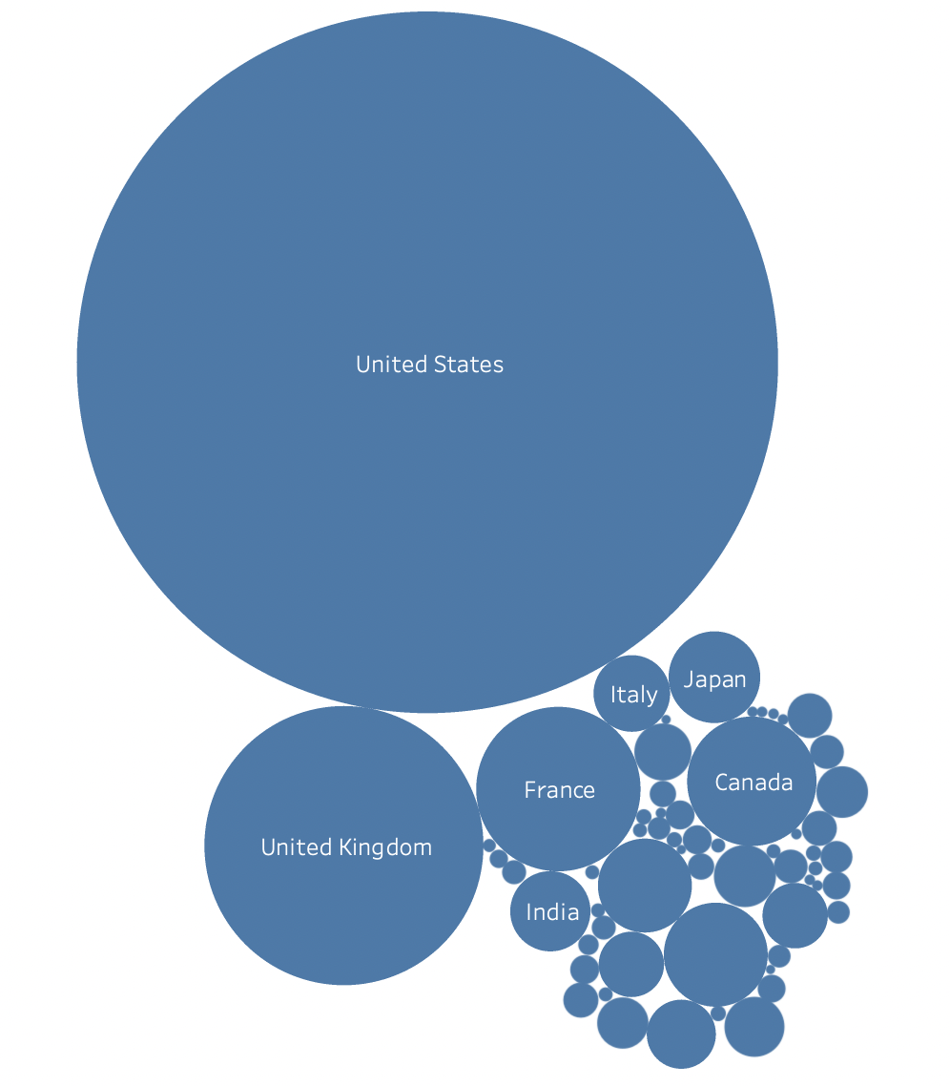
IMDB Score
IMDB Score x Genre
IMDB Score x Country
The results of these visualizations assume that IMDB score is related to the film’s genre and country of origin. To elaborate, comedy, action, and drama received higher IMDB scores whereas Western, Musical, and Historical centered films received incredibly low scores. Moreover, films based in the US received the highest average scores, with the UK and France following in 2nd and 3rd place.

Slide 9
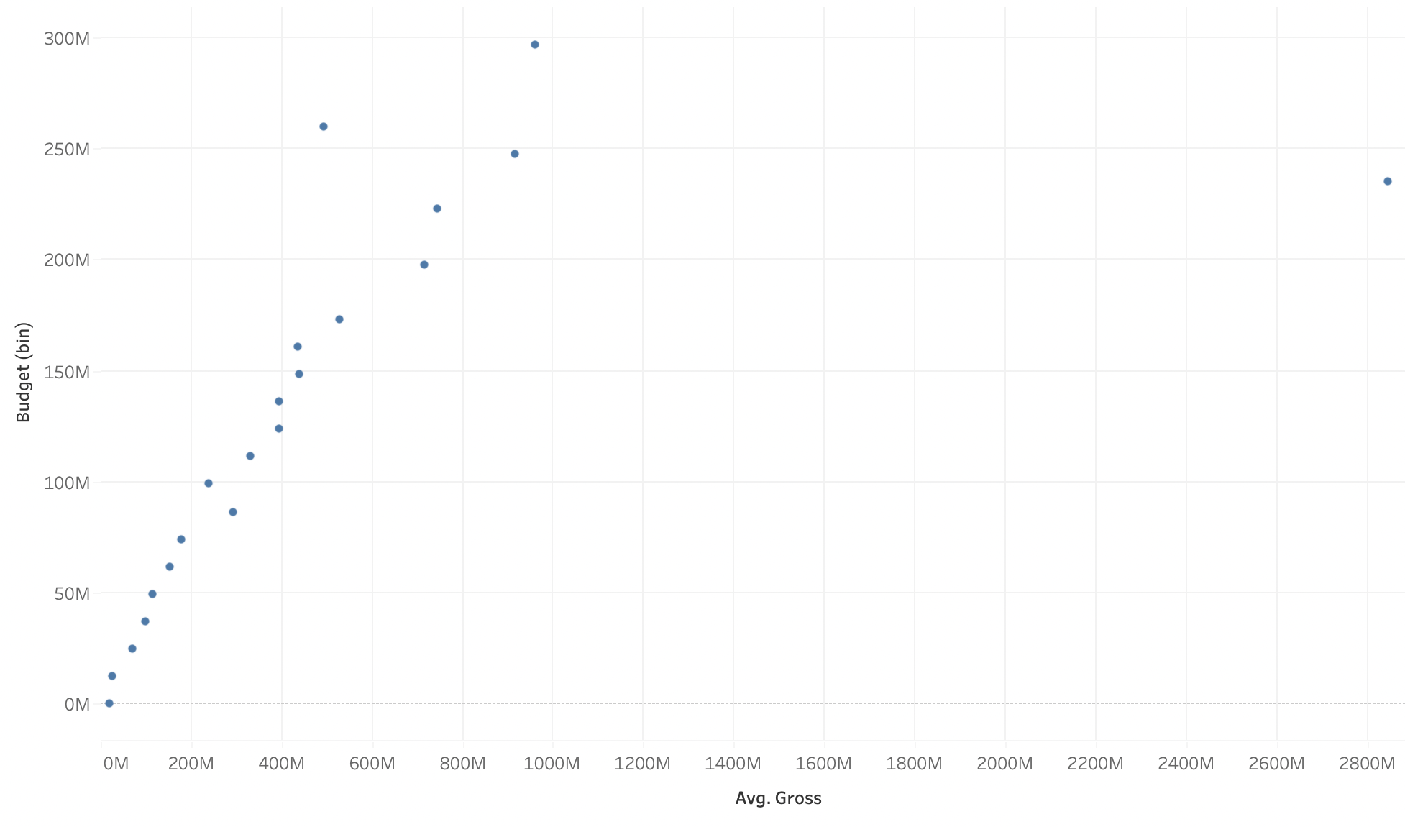
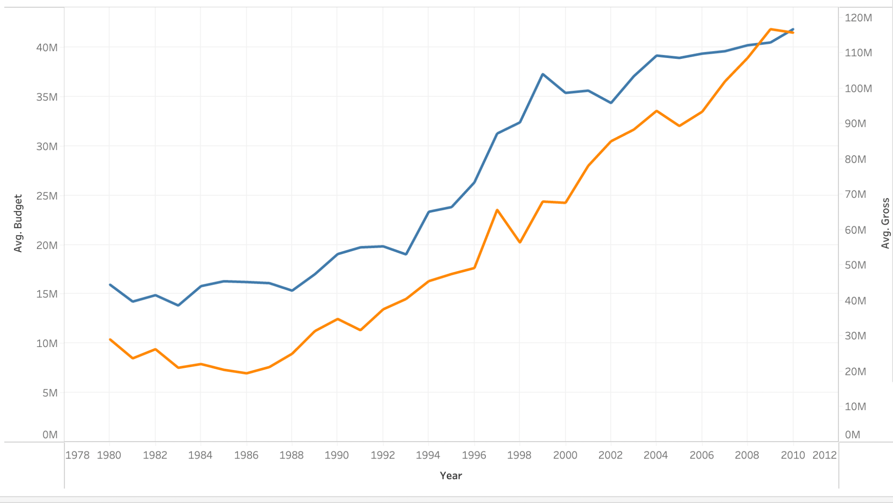
Budget
Budget and average gross revenue are directly related
Avg. Gross

Slide 10
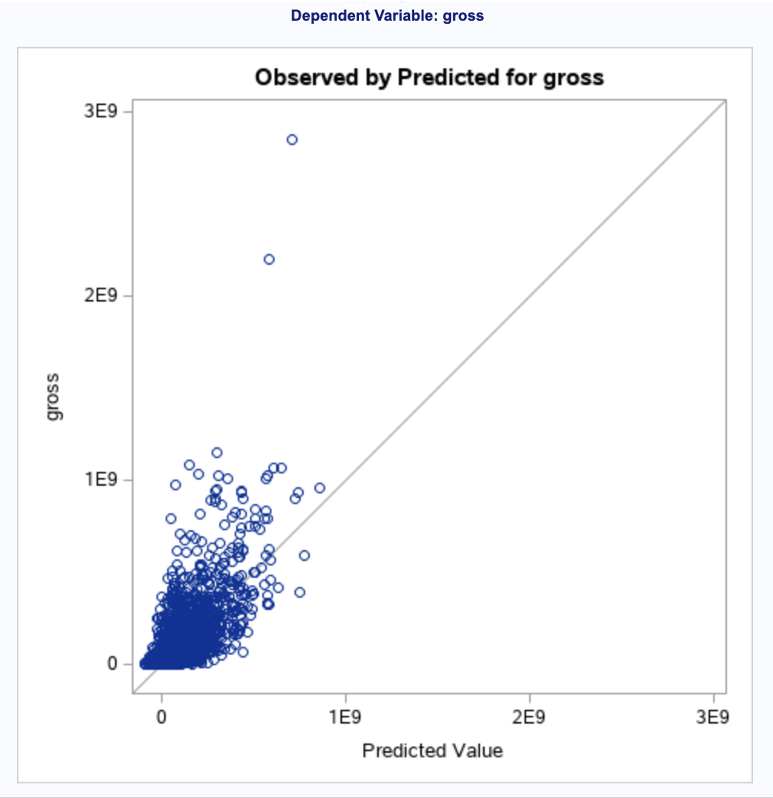
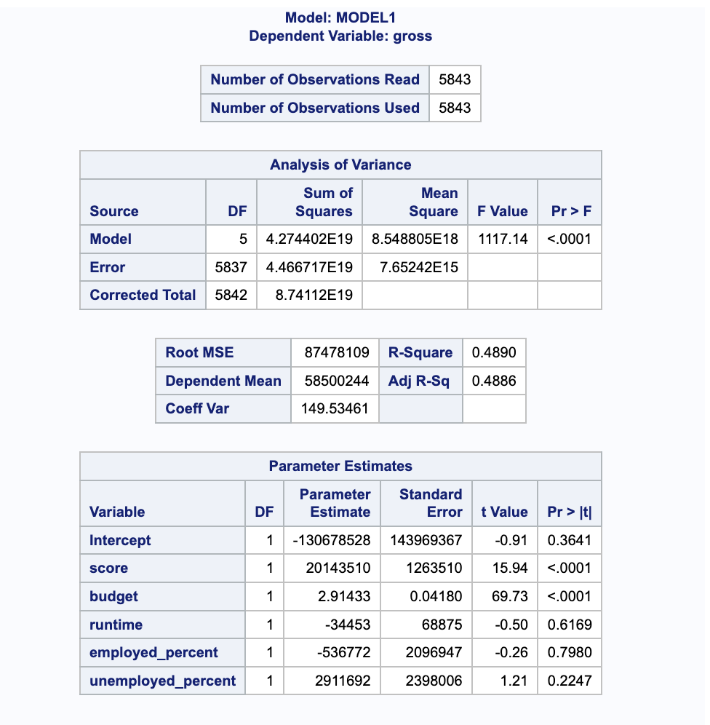
Multivariate Linear Regression Models
This graph shows we had a reasonably strong goodness of fit
Gross = 20143510*score + 2.91433*budget

Slide 11
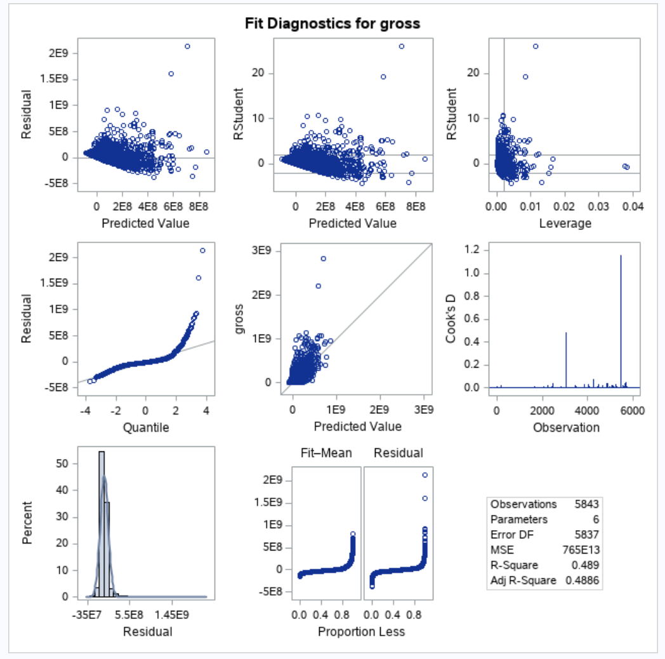
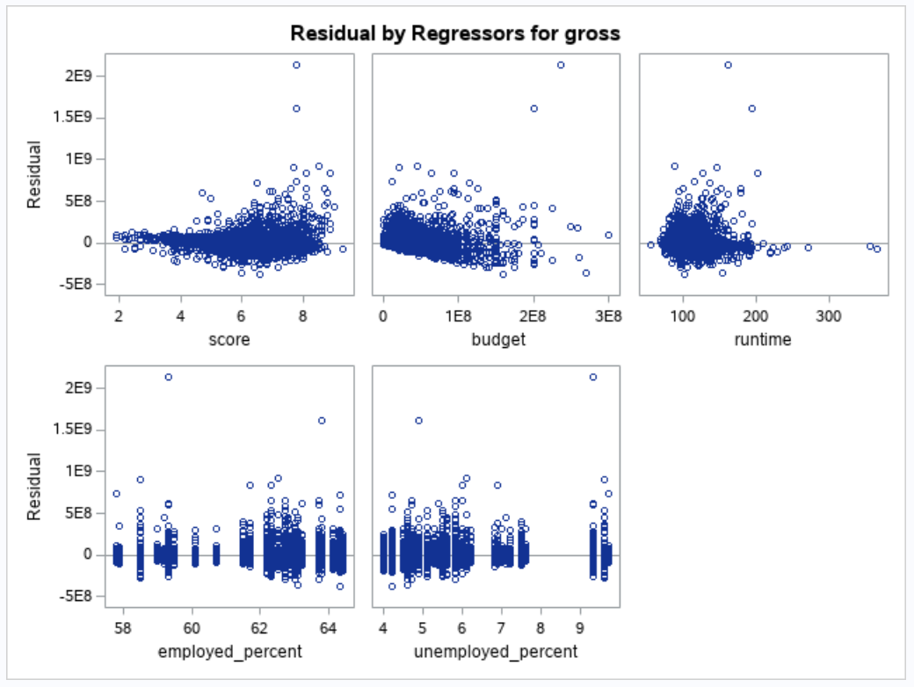

Slide 12
Linear Regression Conclusions
With a strong R-square of 0.489, almost half of our data can be explained by this linear regression model.
R-square is 48.9% which is higher than 30%, reflecting a goodness to fit
Residual Analysis - as most of our values are close to the diagonal line, our actual values are very close to predicted values.

Slide 13
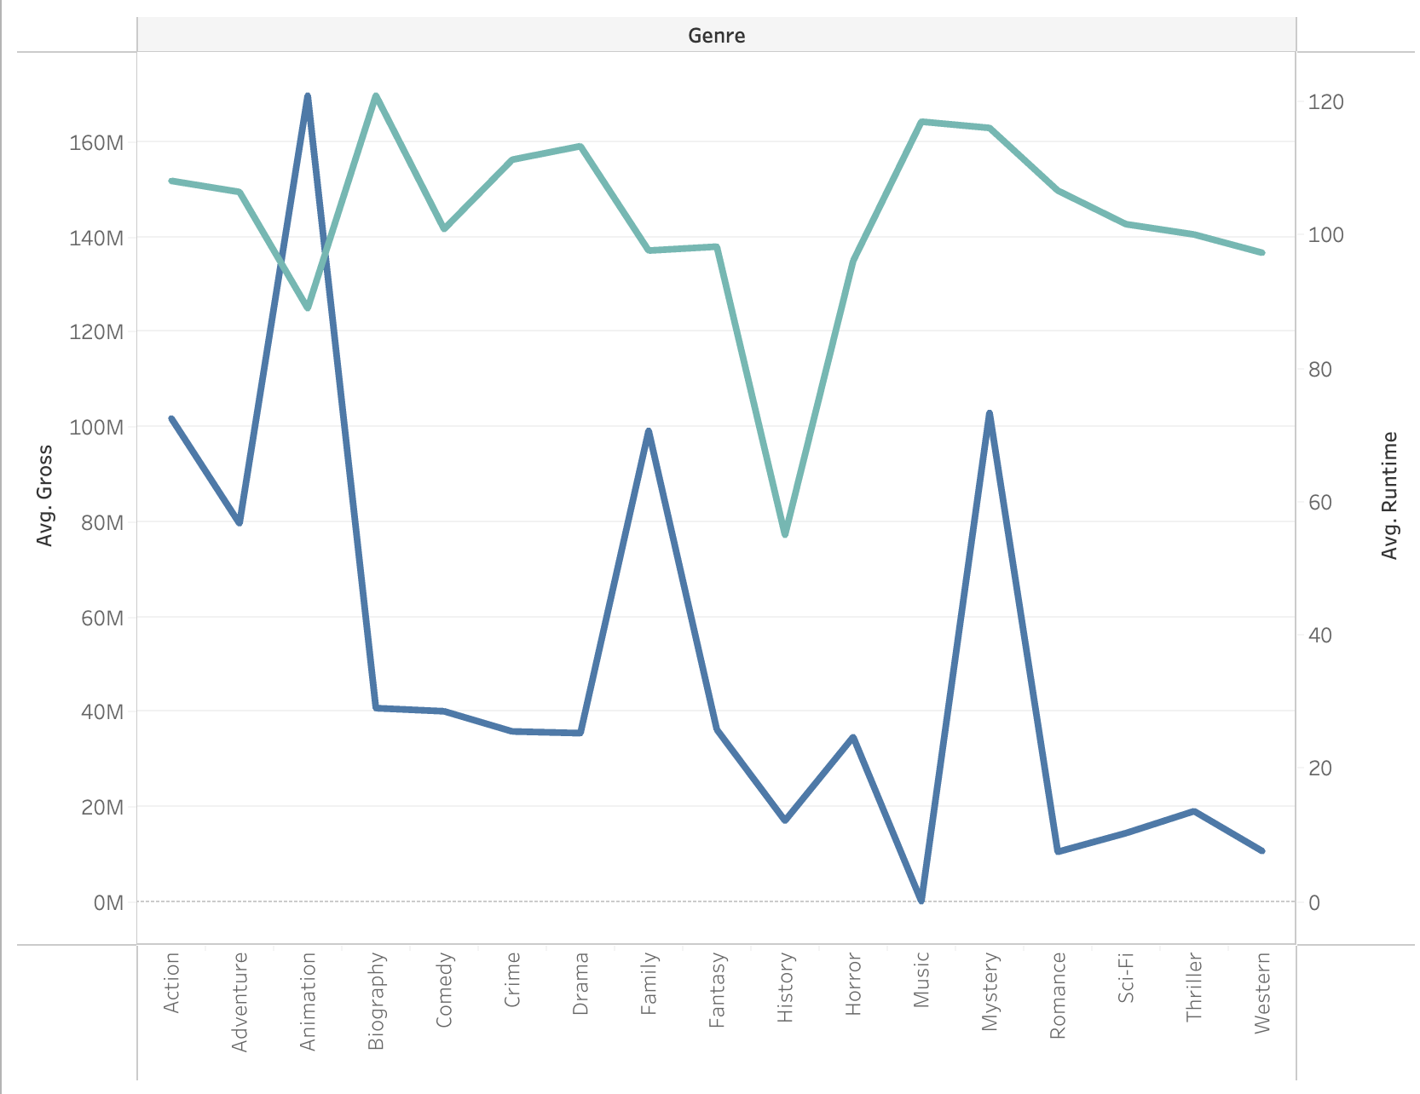
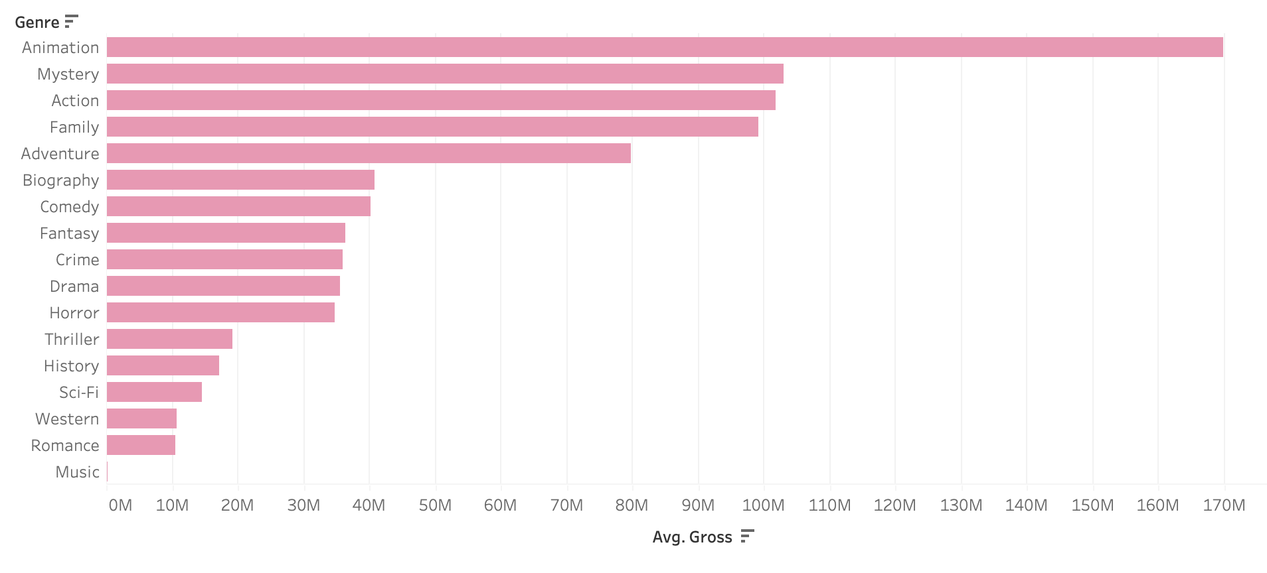
Genre
This chart shows us which genres had the highest (average) revenue, which includes Animation, Mystery and Action. The least earning genres include Music, Romance and Western.
This line chart demonstrates that there is a close relationship between (average) gross revenue and (average) runtime, in relation to genre. Aside a few anomalies such as Animation, genres with a longer average runtime had a higher average gross revenue.

Slide 14
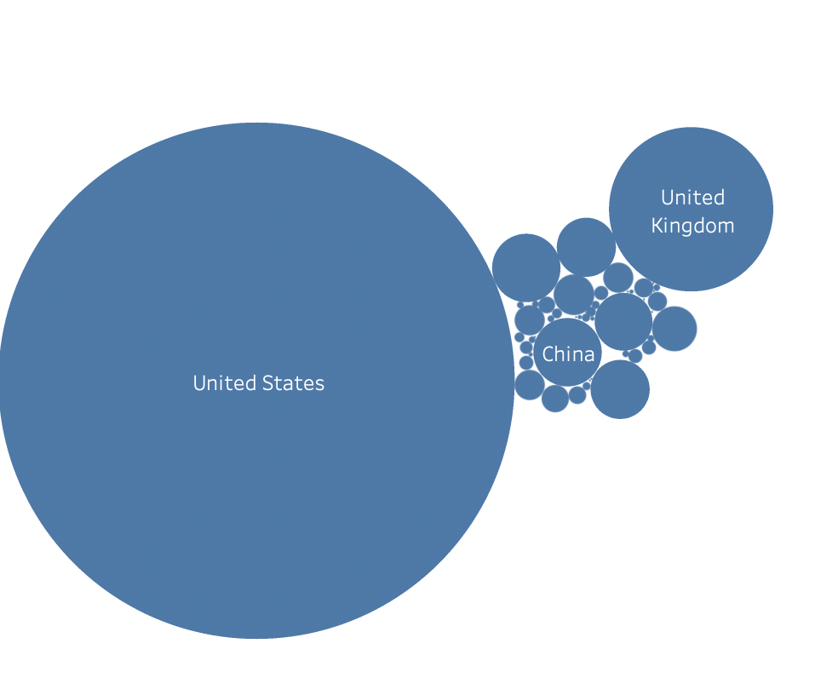
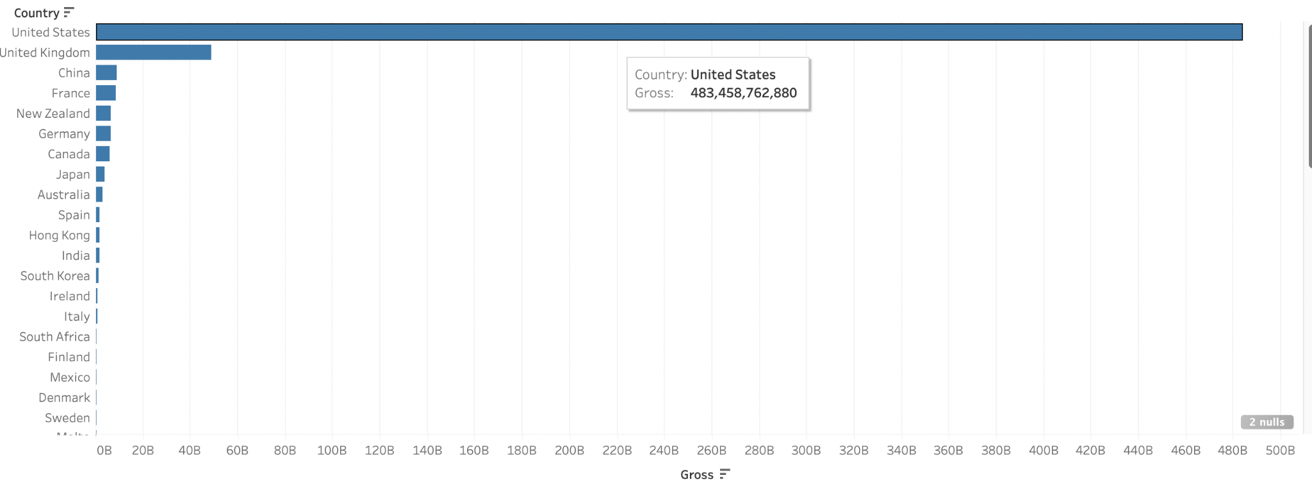
Country
Both graphs show the gross revenue by country, with the United States having the highest gross revenue by far with the UK falling far behind but still being significantly ahead of every country following (China in third, France in fourth)

Slide 15
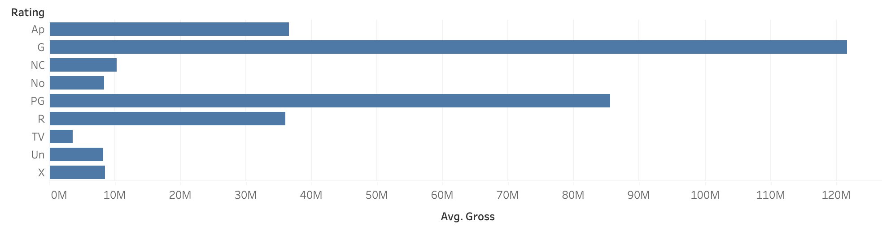
Rating
As shown in the graph, the top 3 maturity ratings in terms of gross revenue were G-rated, PG-rated and R-rated films. This is a logical conclusion, as G-rated movies are available to the widest audiences, PG-rated are the next most widely available, followed by R-rated movies.

Slide 16
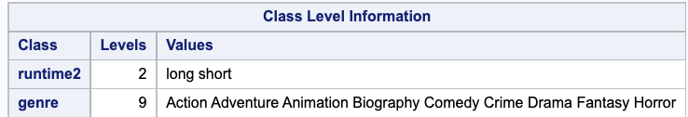
ANOVA
These were the variables we used - runtime and genre. There were 18 combinations we were able to analyze.
( The “runtime2” is the categorical variable converted by “runtime,” the independent numerical variable. If “runtime” <=90, “runtime2” = “short”. If “runtime” >90”, it’s “long.”)

Slide 17
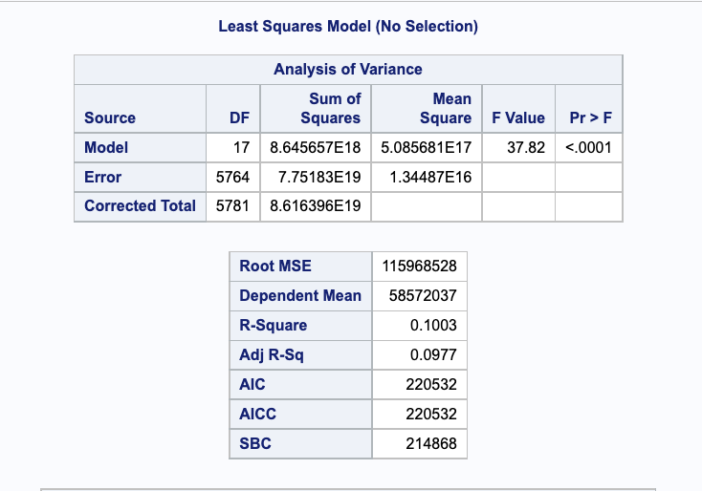
ANOVA
Overall, our ANOVA model is statistically significant with a p value <0.0001
We had a weak R-Square of 0.1003, which indicates our model explains only 10.03% of the total variance

Slide 18
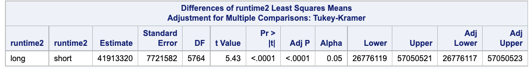
Statistically Significant Differences
This table shows that long movies (>90 minutes) make $41,913,320 more than short movies (90 minutes or less) in gross revenue.
These are the top 3 highest differences we found between genre categories. The table indicates that…
Animated films made $159,000,000 more than Drama movies in gross revenue.
Animated films made $158,000,000 more than Crime movies in gross revenue.
Animated films made $157,000,000 more than Biography movies in gross revenue.

Slide 19
Statistically Significant Interactions
These were the top 3 statistically significant interactions we found. The table indicates that…
Animated movies that lasted more than 90 minutes made $239,000,000 more in gross revenue than Biography movies that lasted 90 minutes or less.
Animated movies that lasted more than 90 minutes made $238,000,000 more in gross revenue than Drama movies that lasted 90 minutes or less.
Animated movies that lasted more than 90 minutes made $236,000,000 more in gross revenue than Crime movies that lasted 90 minutes or less.

Slide 20
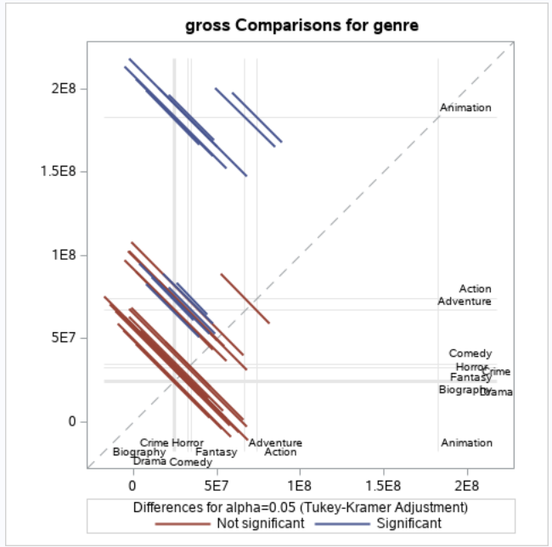
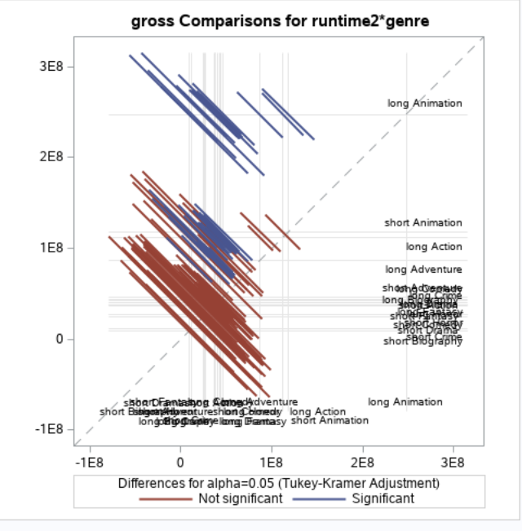
These charts illustrate that the majority of differences and interactions were not significant

Slide 21
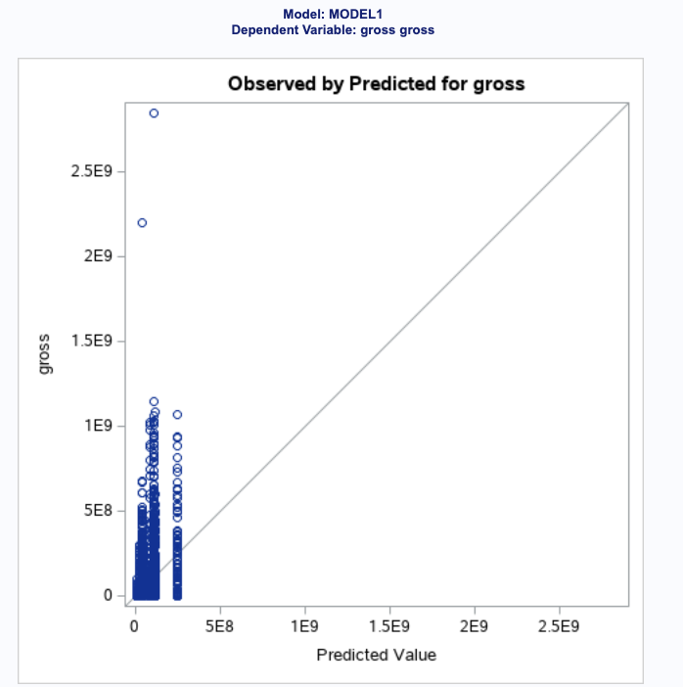
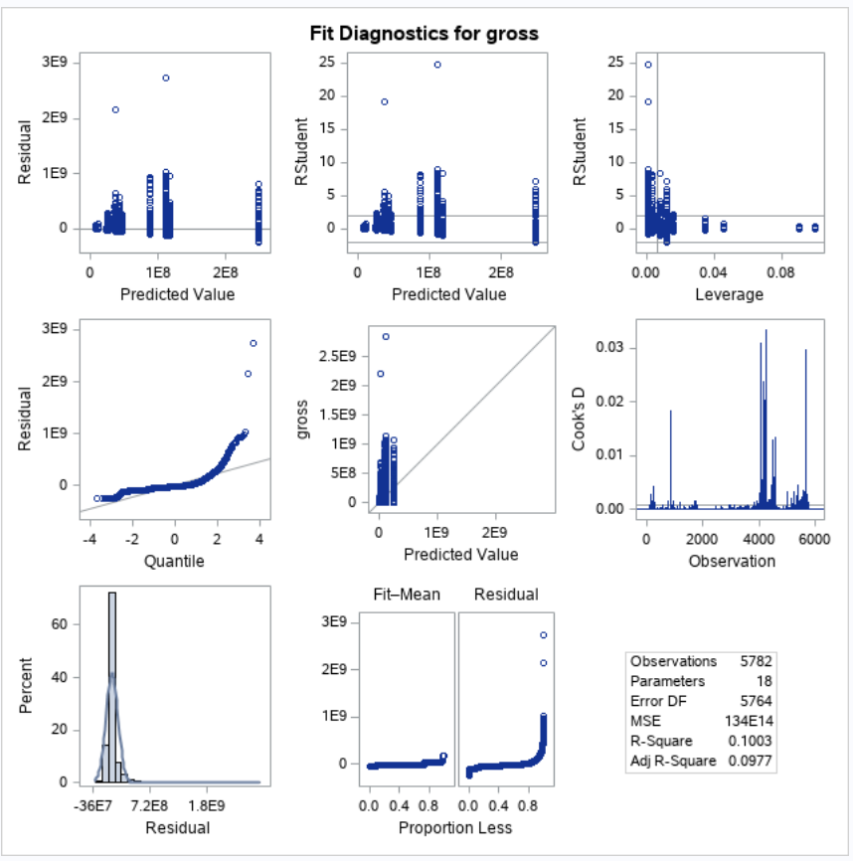
The graph on the left visualizes our weak R-Square. Although some observations on close to the line, most are not on it which indicates that our model has weak accuracy.

Slide 22
Conclusion
The correlations show that all of the independent numerical variables are related to the dependent variable, gross revenue.
However, after further doing Linear Regression models, we found that only “score” and “budget” can be used to predict “gross.” It’s a high-valued model which can explain almost half of our data.
The result of ANOVA indicates long movies (movies that last longer than 90 minutes) make higher revenue, and people also prefer watching animation movies over other genres. Thus, long animation movies are the most profitable. However, this result can only explain 10% of the data according to the weak R square.

Slide 23
Project 2 Appendix: Phase 1 & 2

Slide 24
Phase 1 - Business Goal
Our business goal is to analyze the relationship between gross revenue and several other factors such as yearly unemployment rate, rating, genre, year, country, and more.

Slide 25
Phase 1 - Variables
Dependent Variable: Gross Revenue
Independent Variables: Budget, Runtime, Unemployment Rate, Employment Rate, IMDB Score, Year, Genre, Country, Movie Rating
Numeric Variables: Gross Revenue, Budget, Runtime, Unemployment Rate, Employment Rate, IMDB Score
Categorical Variables: Year, Genre, Country, Movie Rating
Calculated Variables: Unemployment Rate, Employment Rate

Slide 26
Phase 1 - Data Collection
Data Source 1: Movie Industry Analysis - access data set
Data Source 2: US Employment & Unemployment Rate since 1940 - access data set

Slide 27
Phase 1 Summary
Goal Definition
Business Goal: Our business goal is to analyze the relationship between gross revenue and several other factors such as yearly unemployment rate, rating, genre, year, country, and more.
Dependent Variables: Gross Revenue (numeric variable)
Independent Variables:
Numerical Variables: Budget, Runtime, Unemployment Rate, Employment Rate, IMDB Score
Categorical Variables: Year, Genre, Country, Movie Rating
Calculated Variables: Unemployment Rate, Employment Rate
Data Collection
Data Source 1: Movie Industry Analysis - access data set
Data Source 2: US Employment & Unemployment Rate since 1940 - access data set
Notes:
amanda

Slide 28
Phase 2
Data Collection
Number of Observations:
File 1 (Movie Data): 7,668 rows
File 2 (Employment Data): 71 rows
Files: 2 files, inner join (common variable: year of movie release)
Joined File
Dependent variable: 1 (gross revenue)
Independent variables: 10
5,843 rows
Notes:
amanda

Slide 29
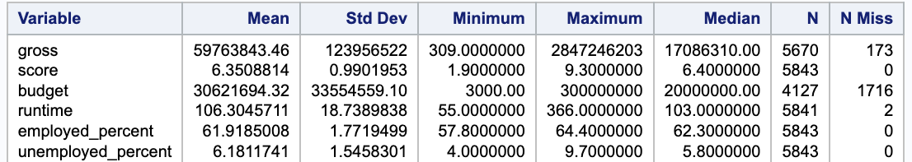
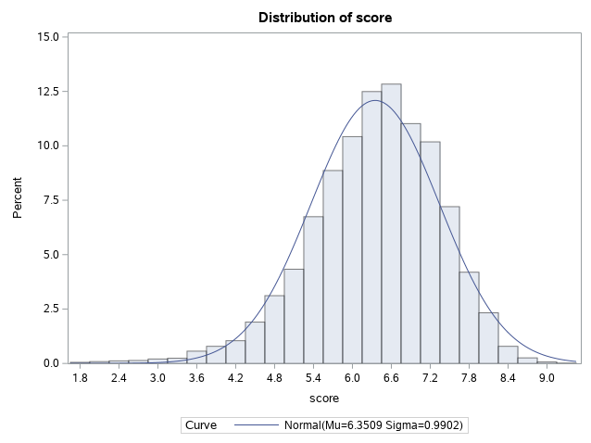
Phase 2 - Descriptive Statistics
The mean and median of score are close to each other, which indicates that the data set has a symmetrical distribution (as confirmed by the normal distribution graph on the right)
Notes:
Jou ann

Slide 30
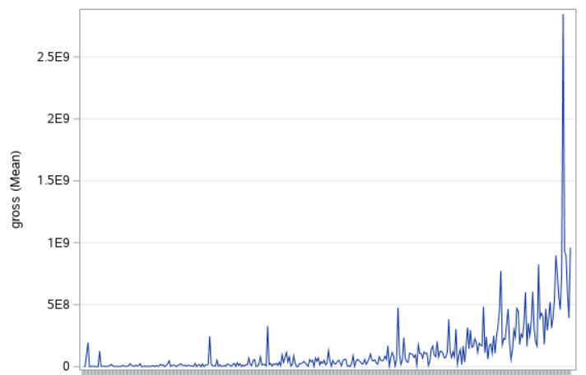
Phase 2 - Gross Revenue x Budget
Revenue increases with budget (direct relationship)
More money spent leads to more money made, with some outliers
Budget
Notes:
kayla

Slide 31
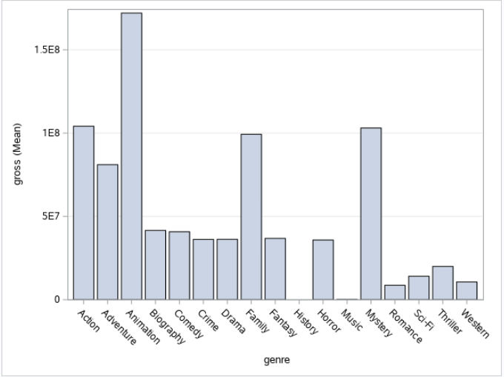
Phase 2 - Gross Revenue x Genre
Animation is the genre with the highest mean gross revenue
Mystery, action, and family movies were the next highest mean revenue
Overall family and children movies averaged highest mean gross revenue, niche genres averaged lower
Notes:
joshsh

Slide 32
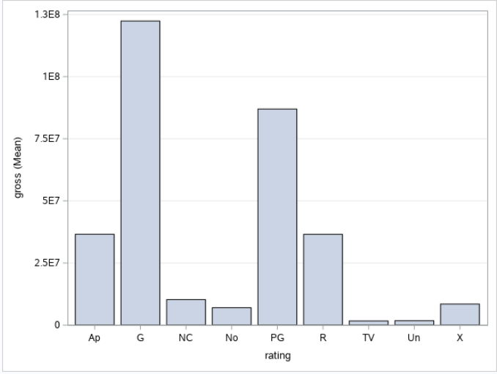
Phase 2 - Gross Revenue x Rating
Rating with the highest mean gross revenue: G, followed by PG
Lower age ratings have higher mean gross revenues
Possible explanation: larger target market in movies with more open age ranges
Notes:
mandy

Slide 33
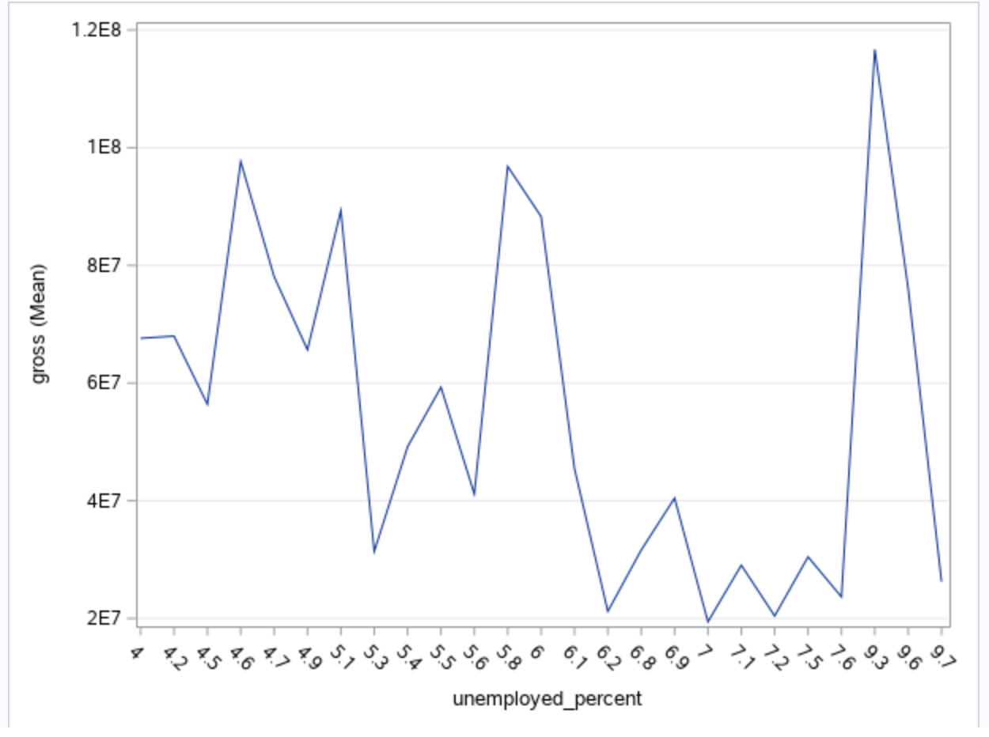
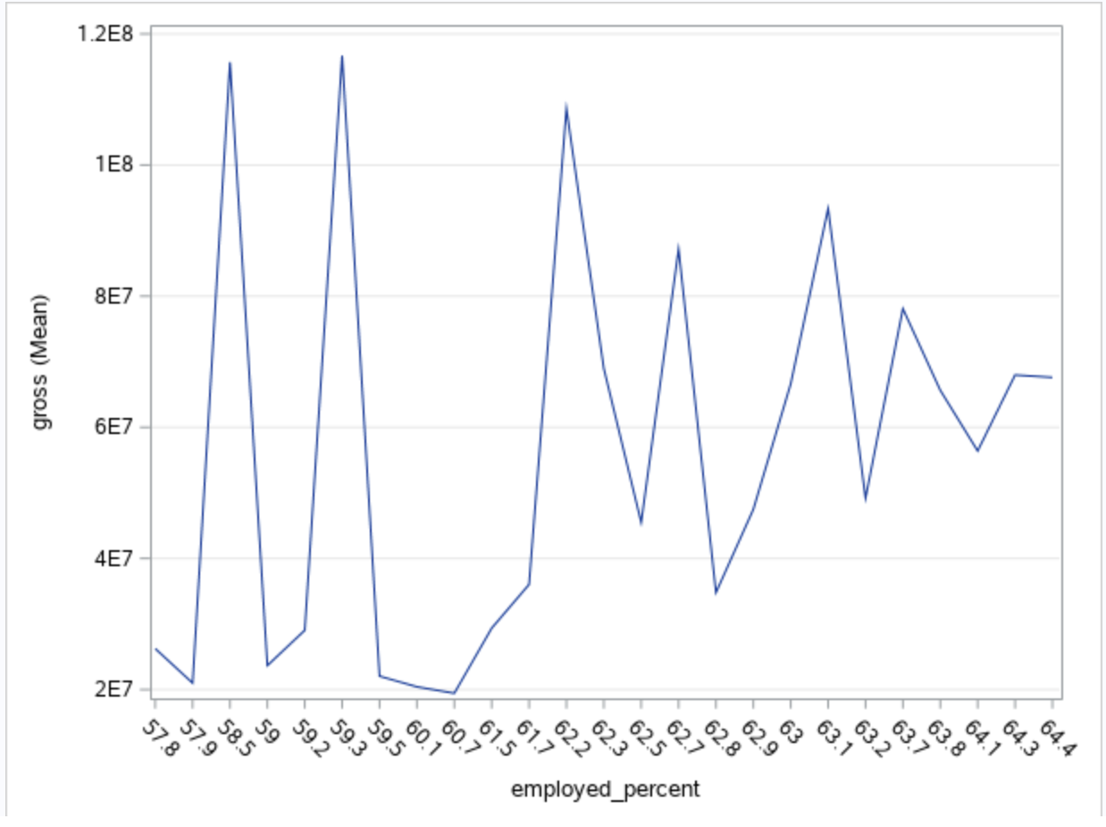
Phase 2
Notes:
brynne

Slide 34
Phase 2 - Interpretation, Action, and Feedback
Factors Impacting Gross Revenue - Conclusions
More family-friendly movies had higher mean gross revenue compared to niche genres and movies with limited age ranges (18+ or parental accompaniment required)
Positive correlation between employment rate and mean gross revenue suggesting better economics conditions lead to more revenue success for films
Notes:
meg

Slide 35
Phase 2 - Interpretation, Action, and Feedback
Recommendations / Decisions Available
Filmmakers can increase mean gross revenue by targeting larger audience ranges
Choosing genres that appeal more to family-friendly audiences (action, animation, family movies) can increase revenue
Release films under better economic conditions (higher employment rate) to increase revenue
There is a direct correlation between budget and gross revenue - filmmakers need to invest more to increase their gross revenue (assuming the movie is successful)
Notes:
selena

Slide 36
Phase 2 - Missing Data
From the original data sets, we deleted the variables (cleaned the data) that were not relevant to our business goal or analysis (director, star of the movie, etc.)
Notes:
selena

